Slide 1

Explorative Data Analysis for E-commerce Buisness
VENKATA SATYA SRIKAR PARVATHA
2200032432@kluniversity.in
STU64de3bbf62a131692285887

Slide 2

PROBLEM STATEMENT
The e-commerce industry generates vast amounts of data daily, encompassing sales transactions, customer interactions, inventory movements, and web traffic.
Despite the availability of this data, many e-commerce businesses struggle to harness its full potential due to challenges in data integration, analysis, and visualization. This leads to suboptimal decision-making, inefficient operations, and missed opportunities for growth and customer engagement.

Slide 3
Project Description
The e-commerce industry generates vast amounts of data from various sources, including sales transactions, customer interactions, inventory levels, and web analytics. This project aims to utilize Power BI to integrate, analyze, and visualize this data, transforming it into actionable insights that can drive strategic decisions, optimize operations, and enhance customer satisfaction. By developing a comprehensive data analysis and visualization solution, the project seeks to address key business challenges and provide a clear view of performance metrics.
The project will involve connecting to multiple data sources such as SQL databases, CRM systems, inventory management platforms, and web analytics tools. Using Power Query Editor, the data will be cleaned and transformed to ensure accuracy and consistency. A robust data model will be developed, establishing relationships between different datasets and creating calculated columns and measures using DAX (Data Analysis Expressions). This will enable detailed analysis of sales trends, customer behavior, inventory management, and web traffic patterns.
Interactive dashboards will be designed to present the analyzed data in an easily understandable and visually appealing manner. These dashboards will include various visual elements like bar charts, line graphs, pie charts, and maps, and will feature slicers, filters, and drill-through capabilities to enhance user interactivity. The dashboards will be published to the Power BI Service, allowing stakeholders to access real-time insights and collaborate effectively. Continuous monitoring and feedback collection will ensure the dashboards remain relevant and valuable, driving data-driven decision-making across the e-commerce business.

Slide 4

Objectives
Sales Analysis
Track sales performance over time
Identify best-selling products and seasonal trends
Customer Insights
Segment customers based on purchasing behavior and demographics
Analyze customer lifetime value and retention rates
Inventory Management
Monitor inventory levels and stock movements
Identify slow-moving products and forecast demand
Web Traffic and Conversion
Analyze website traffic patterns and user behavior
Improve conversion rates through better understanding of user interactions
Operational Efficiency
Develop interactive dashboards to monitor key performance indicators (KPIs)
Enable real-time performance monitoring and data-driven decision-making

Slide 5
Methodology
Requirements Gathering
Conduct meetings with stakeholders to understand their needs and goals. Define the scope, deliverables, and timeline for the project
Data Preparation
Identify data sources and establish connections. Clean and transform data using Power Query Editor to ensure quality and consistency
Data Modeling
Design the data model, establishing relationships and creating necessary measures and calculated columns using DAX .Optimize the model for performance and scalability
Visualization Design
Develop wireframes and design mockups for dashboards and reports. Create interactive visuals using Power BI’s visualization tools
Implementation and Testing
Build and configure dashboards with slicers, filters, and drill-through functionality. Test dashboards with sample data and refine based on feedback
Deployment and Sharing
Publish reports to Power BI Service. Configure data refresh schedules and set up user access and permissions
Monitoring and Maintenance
Set up monitoring for data refresh failures and performance issues. Collect user feedback and make iterative improvements to dashboards

Slide 6
WHO ARE THE END USERS?
Executive Management
Use high-level dashboards to monitor overall business performance and strategic KPIs
Sales and Marketing Teams
Analyze sales trends, customer segments, and campaign performance to optimize strategies
Inventory Managers
Track inventory levels and movements to ensure efficient stock management and reduce costs
Customer Support Teams
Gain insights into customer behavior and satisfaction to improve service quality
Web Analytics Teams
Monitor website traffic and user behavior to enhance user experience and increase conversions

Slide 7

Technology Used
Power BI Desktop
Used for data preparation, modeling, and visualization. Allows for creating interactive reports and dashboards. Features Power Query Editor for data cleaning and transformation. Supports DAX (Data Analysis Expressions) for creating measures and calculated columns.
Power BI Service
Enables publishing, sharing, and collaboration on Power BI reports and dashboards. Facilitates scheduled data refreshes to keep reports up-to-date. Provides secure access to reports and dashboards for stakeholders. Supports data alerts and notifications for real-time monitoring.
DAX (Data Analysis Expressions)
Used for defining custom calculations and aggregations in Power BI. Enables creation of complex measures and calculated columns. Enhances data analysis capabilities within Power BI by allowing sophisticated data manipulations.
Power Query Editor
Integral part of Power BI Desktop for data extraction, transformation, and loading (ETL). Provides a user-friendly interface for cleaning and shaping data. Supports advanced data transformation techniques, such as merging and appending queries, pivoting, and unpivoting data.
SQL
Utilized for querying and extracting data from relational databases. Essential for integrating data from various sources such as sales databases, CRM systems, and inventory management systems. Allows for complex data retrieval and manipulation to prepare data for analysis in Power BI.
Web Analytics Tools (e.g., Google Analytics)
Source of web traffic and user behavior data. Provides insights into website performance, user interactions, and conversion rates. Data from these tools can be integrated into Power BI for comprehensive analysis.

Slide 8
RESULTS

Slide 9
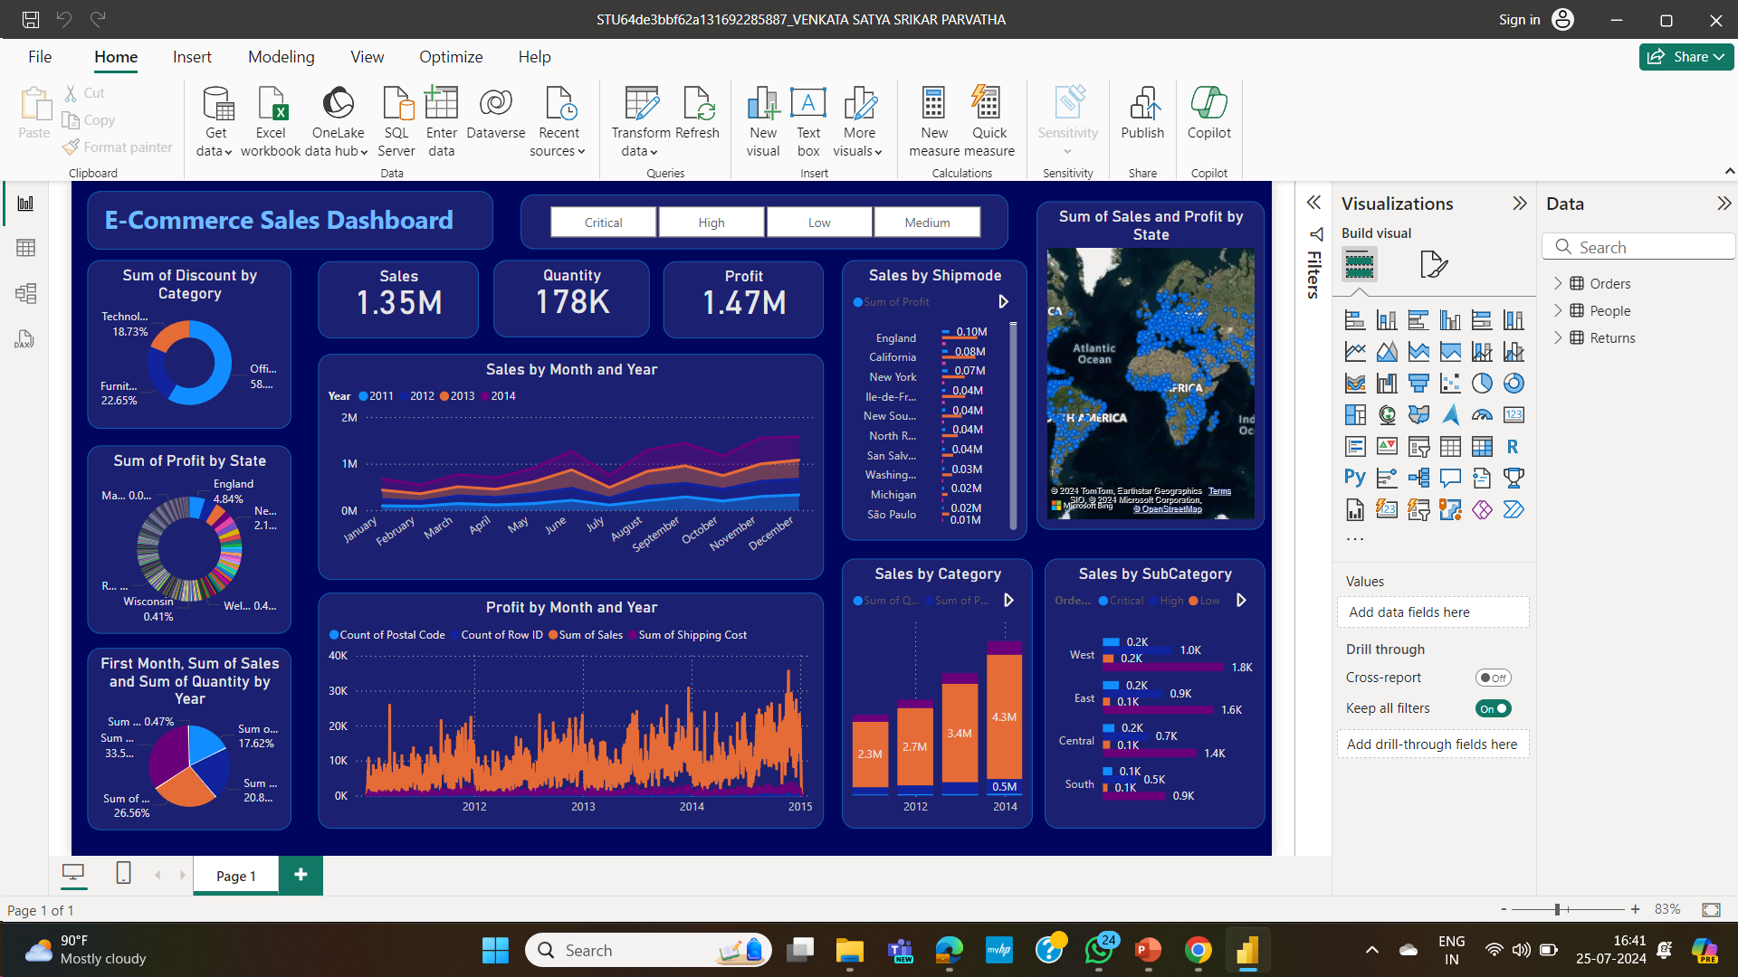

Slide 10
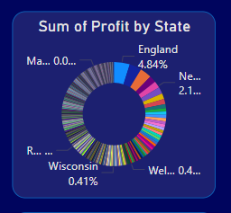
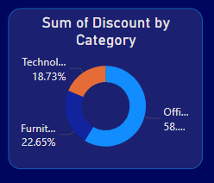
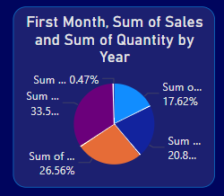

Slide 11
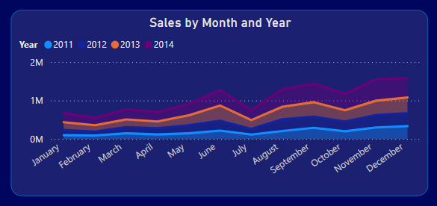
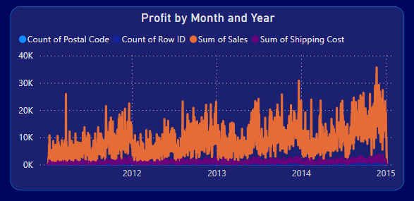

Slide 12
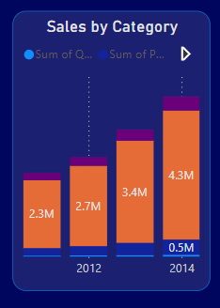
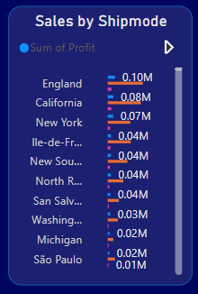


Slide 13
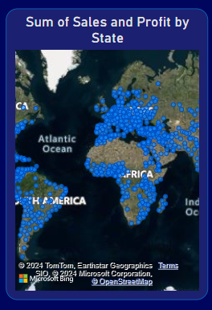

Slide 14
Project File & Data Sets
Git Hub –
VenkataSatyaSrikarParvatha/VOIS (github.com)
https://github.com/VenkataSatyaSrikarParvatha/VOIS/blob/main/STU64de3bbf62a131692285887_VENKATA%20SATYA%20SRIKAR%20PARVATHA.pbix
Visit the link by – ctrl + click
It contains a reference data set taken
A Power BI Executed, for the reference of execution
.
.

Slide 15
References
Zebra BI - How to Create an E-commerce Sales Report in Power BI
How to Create an E-commerce Sales Report in Power BI - Zebra BI
databox.com - 9 Best Ecommerce Reports to Boost Online Sales (Sourced from 30+ Pros)
9 Best Ecommerce Reports to Boost Online Sales (Sourced from 30+ Pros) | Databox
analyticsinsight.net - E-Commerce Analytics with Power BI: A Guide
E-Commerce Analytics with Power BI: A Guide (analyticsinsight.net)
.
.

Slide 16
Conclusion
The successful implementation of a comprehensive data analysis and visualization solution using Power BI will significantly enhance the decision-making capabilities of the e-commerce business. By integrating data from multiple sources and transforming it into meaningful insights, the project will address key challenges in sales analysis, customer insights, inventory management, and web traffic analysis.
Interactive dashboards will provide stakeholders with real-time, actionable insights, enabling them to make informed decisions, optimize operations, and improve customer satisfaction. The use of advanced technologies such as Power BI Desktop, Power BI Service, DAX, Power Query Editor, SQL, and web analytics tools ensures that the data is accurate, consistent, and effectively presented.
Ultimately, this project will empower the e-commerce business to leverage its data assets fully, driving growth and maintaining a competitive edge in the market. The continuous monitoring and iterative improvements will ensure that the solution remains relevant and valuable, adapting to the evolving needs of the business.
.
.

Slide 17
Thank you
.
.

